Slide 1

AegisMind : Cyber Threat Detection using Agentic AI (SDG 9 : Industrial, Innovation and Infrastructure)
Nishant Dakua - 23106014
Arif Choudhary - 23106054
Rushi Choraghe - 23106033
Aryan Kotur - 23106094
Project Guide
Mr. Vijesh Nair
Academic year 2025-26
Notes:
1

Slide 2
Introduction
AegisMind is a groundbreaking, AI-powered agentic layer designed for autonomous cyber defense and counterattack. It's a plug-and-play solution that seamlessly integrates into any digital environment.
Leverages Large Language Model (LLM) reasoning for complex threat analysis.
Utilizes Deep Reinforcement Learning (DRL) for unparalleled adaptability.
Features memory-driven evolution, learning from every interaction.
Deployable via SDK to websites, APIs, and SaaS products.
Notes:
2

Slide 3



Sustainable Development Goal:
Goal 9: Industry, Innovation & Infrastructure
Goal 16: Peace, Justice & Strong Institutions
AegisMind fosters resilient infrastructure by providing advanced cyber defense, enabling innovation without security compromise.
By securing digital systems, AegisMind contributes to stable, secure institutions and a more peaceful cyberspace.
Goal 4: Quality Education
AegisMind's adaptive learning capabilities implicitly contribute to knowledge systems, securing educational digital platforms and data.

Slide 4
Literature Survey
“Design of an autonomous cyber defence agent using hybrid ai models.”, IEEE
Hybrid AI agent combines DRL, LLMs, and rules to defend cyber networks autonomously.
Tested in CybORG, the agent defends against red team strategies using monitoring and decoys.
Lacks real-world deployment; evaluation limited to simulated CybORG test environments only.
“Game Theory Meets LLM and Agentic AI: Reimagining Cybersecurity for the Age of Intelligent Threats.”
Traditional cybersecurity methods are failing against advanced, AI-powered threats due to their reactive and static nature.
The research also explores how AI agents, working in multi-agent systems, can revolutionize game theory itself by creating more realistic models of bounded rationality and complex interactions, while also highlighting the critical need to address ethical considerations like accountability and bias in these autonomous systems.

Slide 5
Limitations in Existing Systems:
Reactive systems that respond only after an attack.
Limited protection against unknown zero-day vulnerabilities.
Heavy reliance on human intervention, leading to alert fatigue and slower response times.
Inability to adapt quickly to novel attack vectors

Slide 6
Problem statement
How can we defend against AI-powered, zero-day cyber threats without relying on static rules?
Can we build a system that simulates attacker behavior and reasons in real time?
What if cyber defense could learn, adapt, and evolve like a living system?
Can we create an autonomous, plug-and-play AI shield for any digital platform?

Slide 7
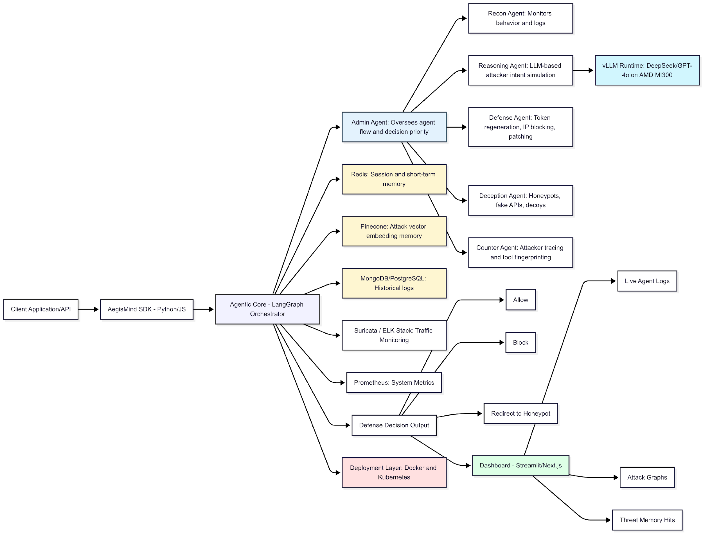
Proposed Solution:
Notes:
7

Slide 8







Experimental Setup:
Frontend
Backend
Agent Logic
AI Models
Next.js
Flask
vLLM with DeepSeek 70B
Python + LangGraph
Monitoring
Storage
Redis, Pinecone,
MongoDB
Suricata, ELK,
Prometheus
LLM Reasoning
DRL Adaptability
Advanced language models enable complex threat analysis and decision-making, understanding nuanced attack patterns.
Deep Reinforcement Learning allows AegisMind to learn and adapt autonomously to evolving cyber threats in real-time.
Vector Memory
Utilizes vector databases for efficient long-term memory, enabling historical analysis and predictive threat intelligence.
Notes:
8

Slide 9
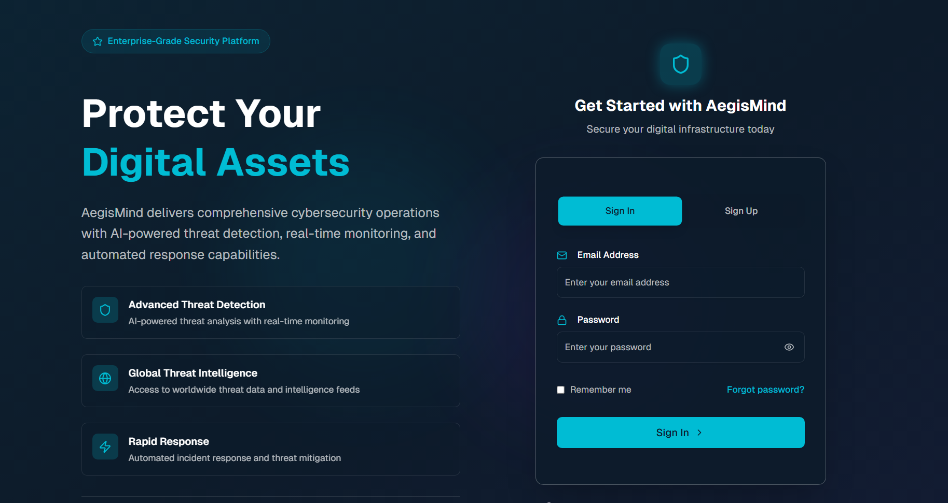
Implementation
LOGIN AND SIGN UP PAGE

Slide 10
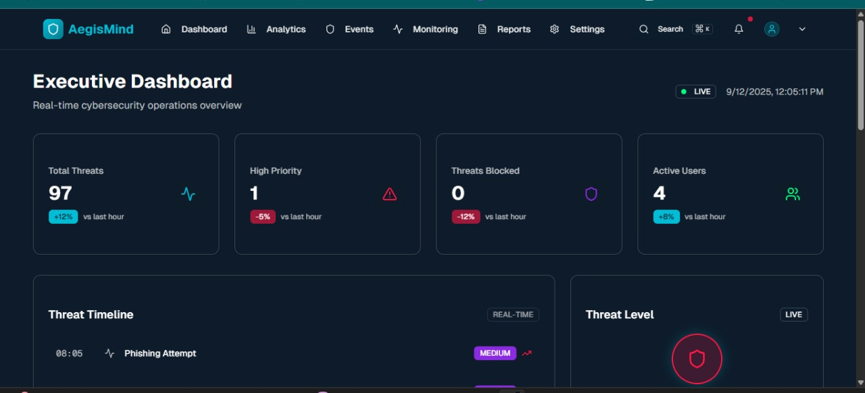
Dashboard with all details real time thread details

Slide 11
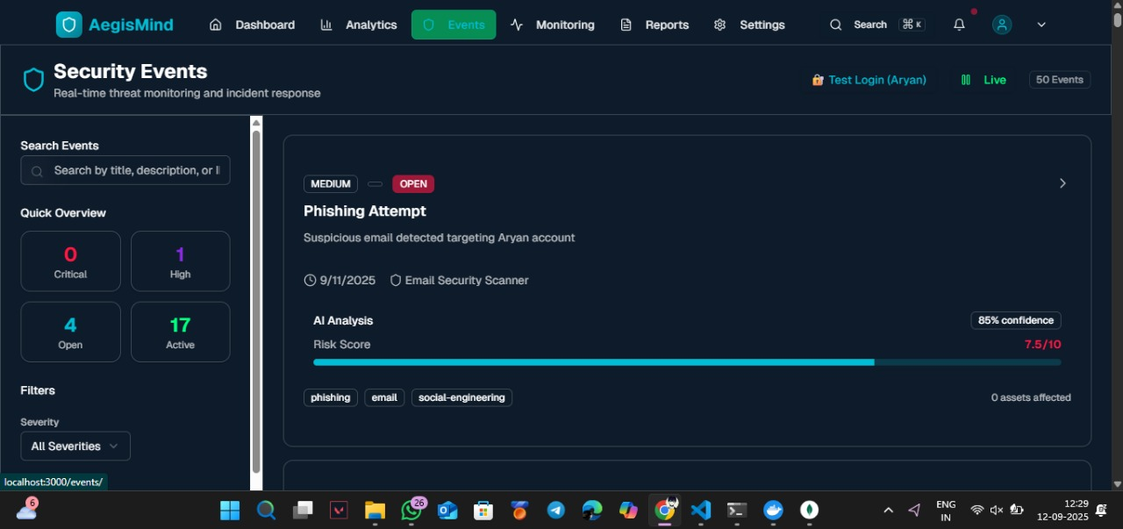
All Security Event

Slide 12
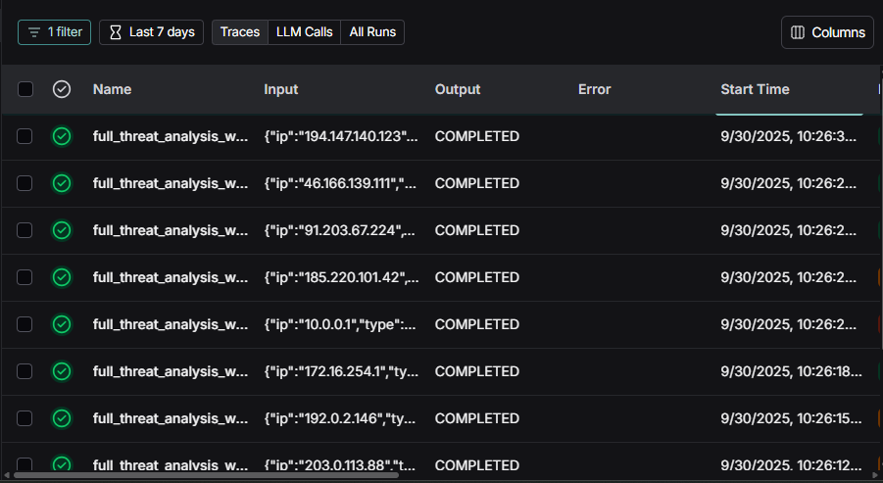
All the Analysed Thread

Slide 13
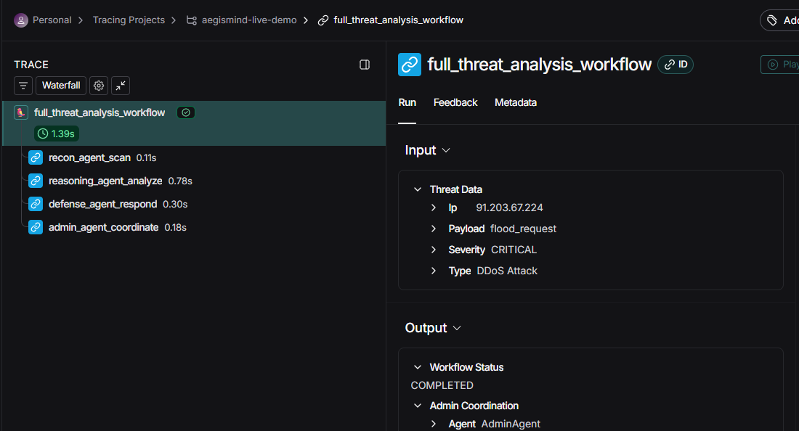
Detail Analysis

Slide 14
Feature | Base Llama-2 Model | Fine-tuned `llama-2-7b-cyberllm` Model
Perplexity | ~10.23 (on sample data) | ~10.51 (on sample data)
Output Style | Free-form, narrative, human-readable text | Attempted JSON structure, machine-readable intent
Content | General cybersecurity analysis | Structured threat analysis following a defined JSON schema
Use Case | General understanding, human consumption | Automated threat parsing, integration with security tools
Key Advantage | Broad knowledge, natural language fluency | Structured output, potential for automation and data extraction

Slide 15
Conclusion
An Agentic AI–based cybersecurity system for real-time threat detection and autonomous response.
Addresses limitations of traditional security systems that rely on static rules and manual intervention.
Uses Large Language Models (LLMs) to analyze logs, network traffic, and user behavior to understand attacker intent.
Employs multiple intelligent agents (recon, reasoning, defense, admin) that collaborate to detect, analyze, and mitigate threats.
Capable of handling zero-day and AI-powered cyber attacks through adaptive learning.
Provides a scalable, modular, and real-time monitoring dashboard for security insights.
Supports UN SDG 9 (Industry, Innovation & Infrastructure) by strengthening secure digital infrastructure.

Slide 16
Future work
TRACK 1:
Developing an SDK that enables seamless integration of our solution into any project. The SDK allows developers to easily adopt and customize the system for their specific use cases. It provides well-documented APIs and modular components for flexible deployment.
TRACK 2:
The model is fine-tuned using domain-specific cybersecurity datasets such as threat logs, attack reports, and vulnerability descriptions. Supervised learning and reinforcement techniques are applied to improve threat classification and response accuracy.

Slide 17
Research & References:
[1] J. S. Park, D. Y. Kim, and J. H. Lee, “AI-Based Adaptive Cyber Threat Detection: A Survey,” IEEE Commun. Surveys Tuts., 2022.
[2] Z. Zhou, C. Qin, and X. Wang, “Deep Learning for Cybersecurity: A Review,” ACM Comput. Surveys, 2023.
[3] S. Shrestha et al., “Real-Time Big Data Analytics for Cyber Threat Detection,” IEEE Access, 2020.
[4] H. D. Nguyen and J. Choi, “Benchmark Datasets for Intrusion Detection Systems,” J. Netw. Comput. Appl., 2020.

Slide 18
Thank You...!!
Notes:
18

